Slide 1


Advanced Node.js
File System, Streams, Events, Debugging
Vasil Dininski
Junior Software Developer
http://www.vasil.me
Telerik Corporation
http:/telerikacademy.com

Slide 2

Table of Contents
Node.js behind the scenes
Working with the file system
Synchronous actions
Asynchronous actions
Streams
Buffers
Events

Slide 3
Table of Contents
Debugging node.js applications
Tools
Node-inspector
Debug protocol

Slide 4

Node.js behind the scenes
Single or multi-threaded?

Slide 5
Node.js behind the scenes
Evented I/O
Don’t call us, we’ll call you
Non-blocking
Asynchronous
Event loop
Worker threads and the V8 engine
The event loop is single-threaded, but underneath relies on an internal pool of C++ threads

Slide 6
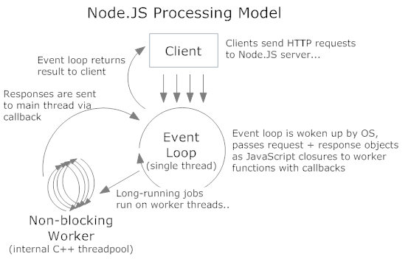
Node.js behind the scenes
Node.js processing model

Slide 7
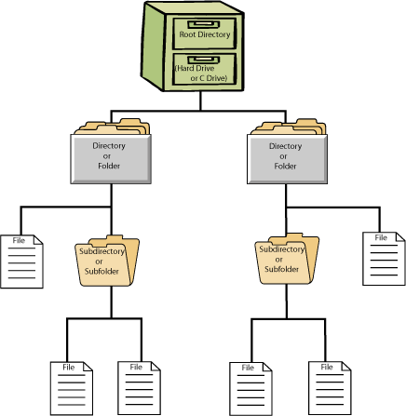
Working with the file system

Slide 8
Working with the file system
The fs module
Two ways to tackle working with fs:
Synchronous
Asynchronous (the node.js way)
Synchronous
var fs = require(“fs”);
fs.mkdirSync(path, [mode]);
fs.renameSync(oldPath, newPath);
fs.writeFileSync(filename, data, [options]);

Slide 9
Working with the file system
Asynchronous
Official documentation
http://nodejs.org/api/fs.html
fs.mkdirSync(path, [mode], callback);
fs.renameSync(oldPath, newPath, callback);
fs.writeFileSync(
filename, data, [options], callback);

Slide 10
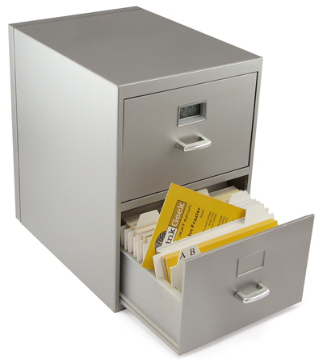
Working with fs
Live demo

Slide 11
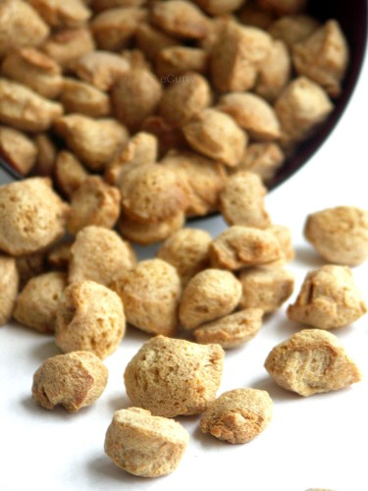

Streams
Streams, buffers and chunks

Slide 12
Streams
Types
Readable – can only be read (process.stdin)
Writeable – can only be written to (process.stdout)
Duplex – both Readable and Writeable (tcp sockets)
Transform – Duplex streams where the output is computer from the input (zlib, crypto)

Slide 13
Streams
Buffers
JS is unicode friendly, but not the best when it comes to binary data.
Handles octet streams
Can be easily transformed into JS object by setting an encoding in the buffer’s toString() method

Slide 14
Streams
Readable stream
Events
readable, data, end, close, error
Methods
read, pause, resume, pipe, unpipe, unshift
Implementation interface
_read(size)
push(chunk, [encoding])

Slide 15

Readable streams
Live demo

Slide 16
Streams
Writeable stream
Events
Drain, finish, pipe, unpipe, error
Methods
write, end
Implementation interface:
_write(chunk, encoding, callback)

Slide 17

Writeable streams
Live demo

Slide 18
Streams
Duplex stream
Implements both the Readable and Writeable interfaces
Example - a TCP socket
Transform stream
A special kind of duplex stream where the output is a transformed version of the input
_transform(chunk, encoding, callback)
http://codewinds.com/blog/2013-08-20-nodejs-transform-streams.html

Slide 19

Duplex and Transform
Live demo

Slide 20

Events

Slide 21
Events
Huge application in node.js applications
Many objects in node.js emit events, i.e. are EventEmitters. Examples are fs, net, zlib, etc.
Basically an implementation of the publish/subscribe pattern

Slide 22

EventEmitter
Live demo

Slide 23

Debugging

Slide 24
Debugging in node.js
Debugging in node.js
The V8 debug protocol
JSON based protocol
IDEs with a debugger
Webstorm
Visual Studio
Sublime Text (+node.js plugin)
Node-inspector (awesomeness!)

Slide 25
Debugging
Live demo

Slide 26
http://algoacademy.telerik.com

Slide 27



Free Trainings @ Telerik Academy
“C# Programming @ Telerik Academy
csharpfundamentals.telerik.com
Telerik Software Academy
academy.telerik.com
Telerik Academy @ Facebook
facebook.com/TelerikAcademy
Telerik Software Academy Forums
forums.academy.telerik.com

